Slide 1
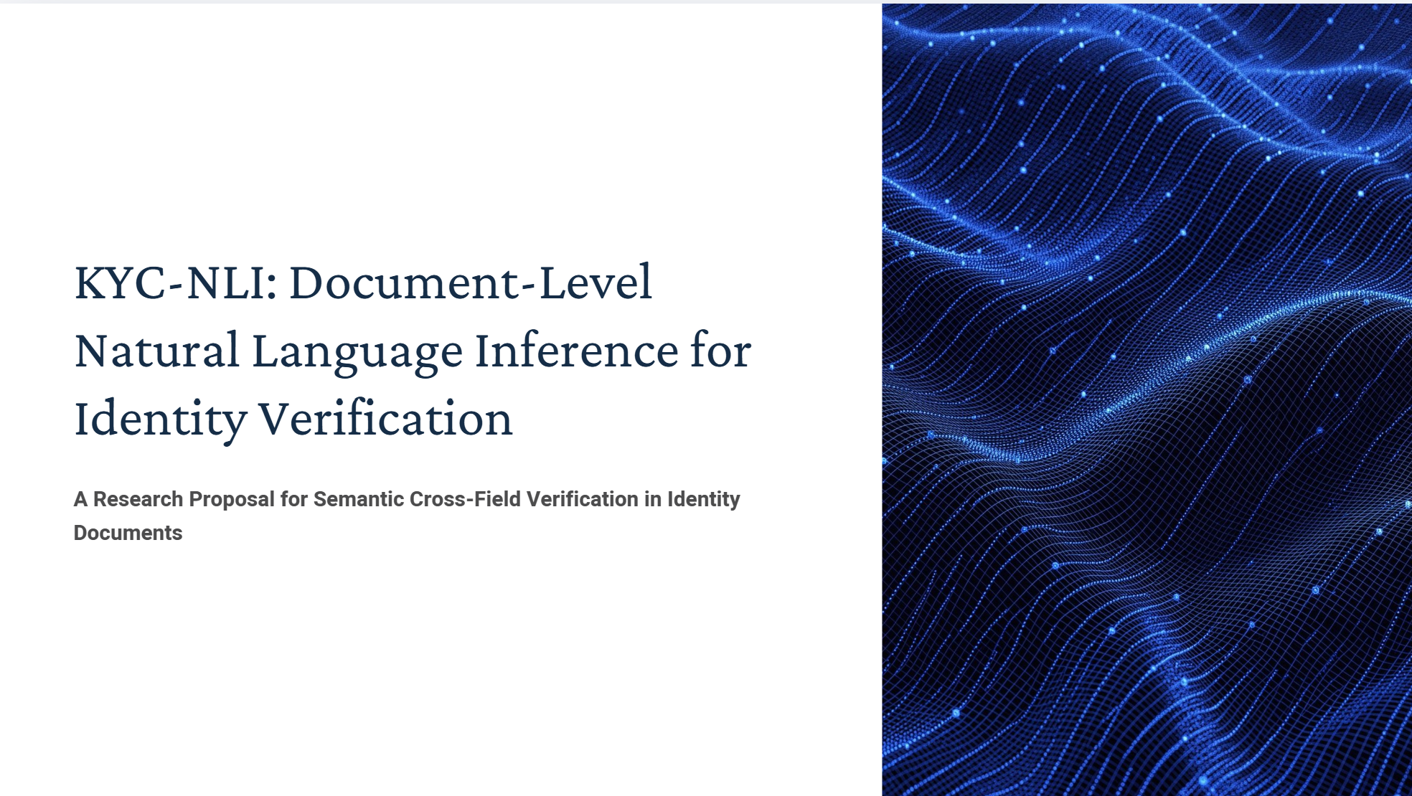

Slide 2
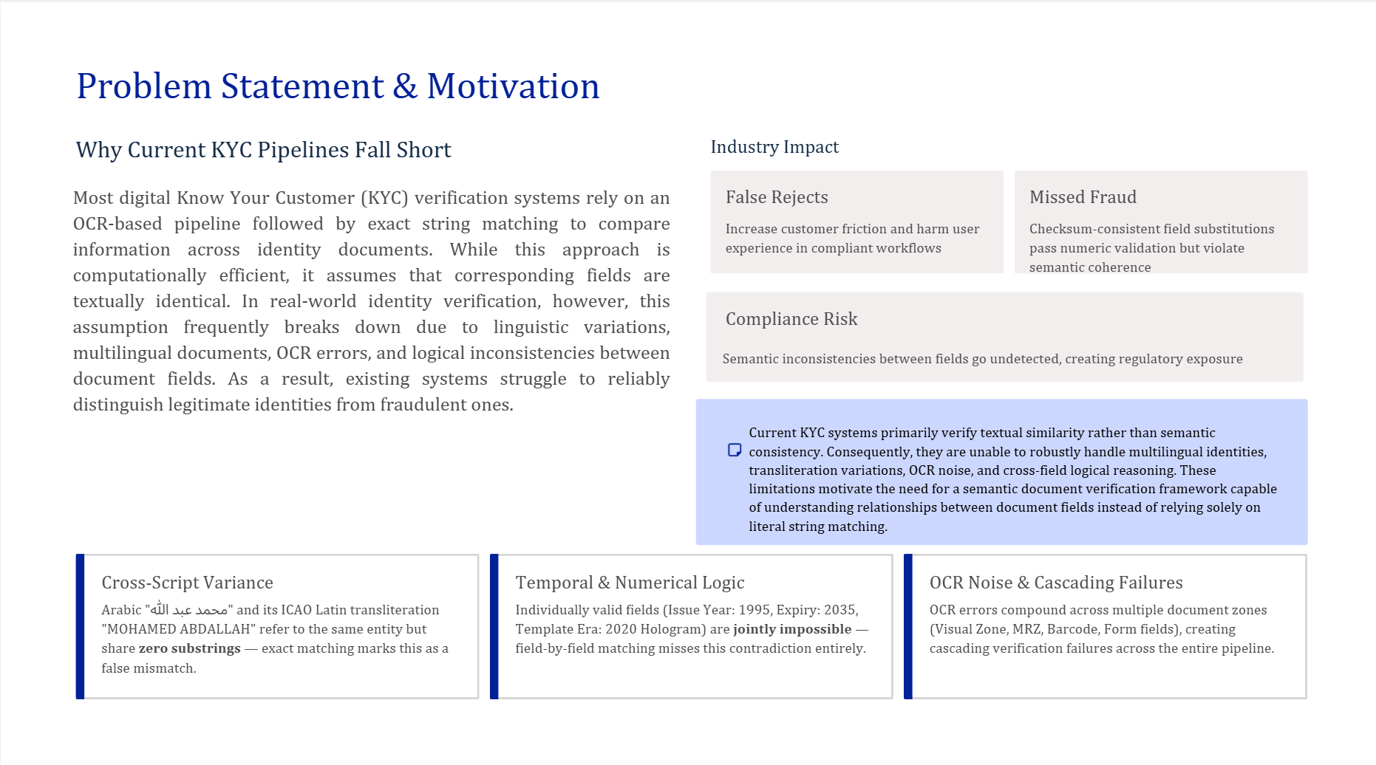
1 / 16

Slide 3
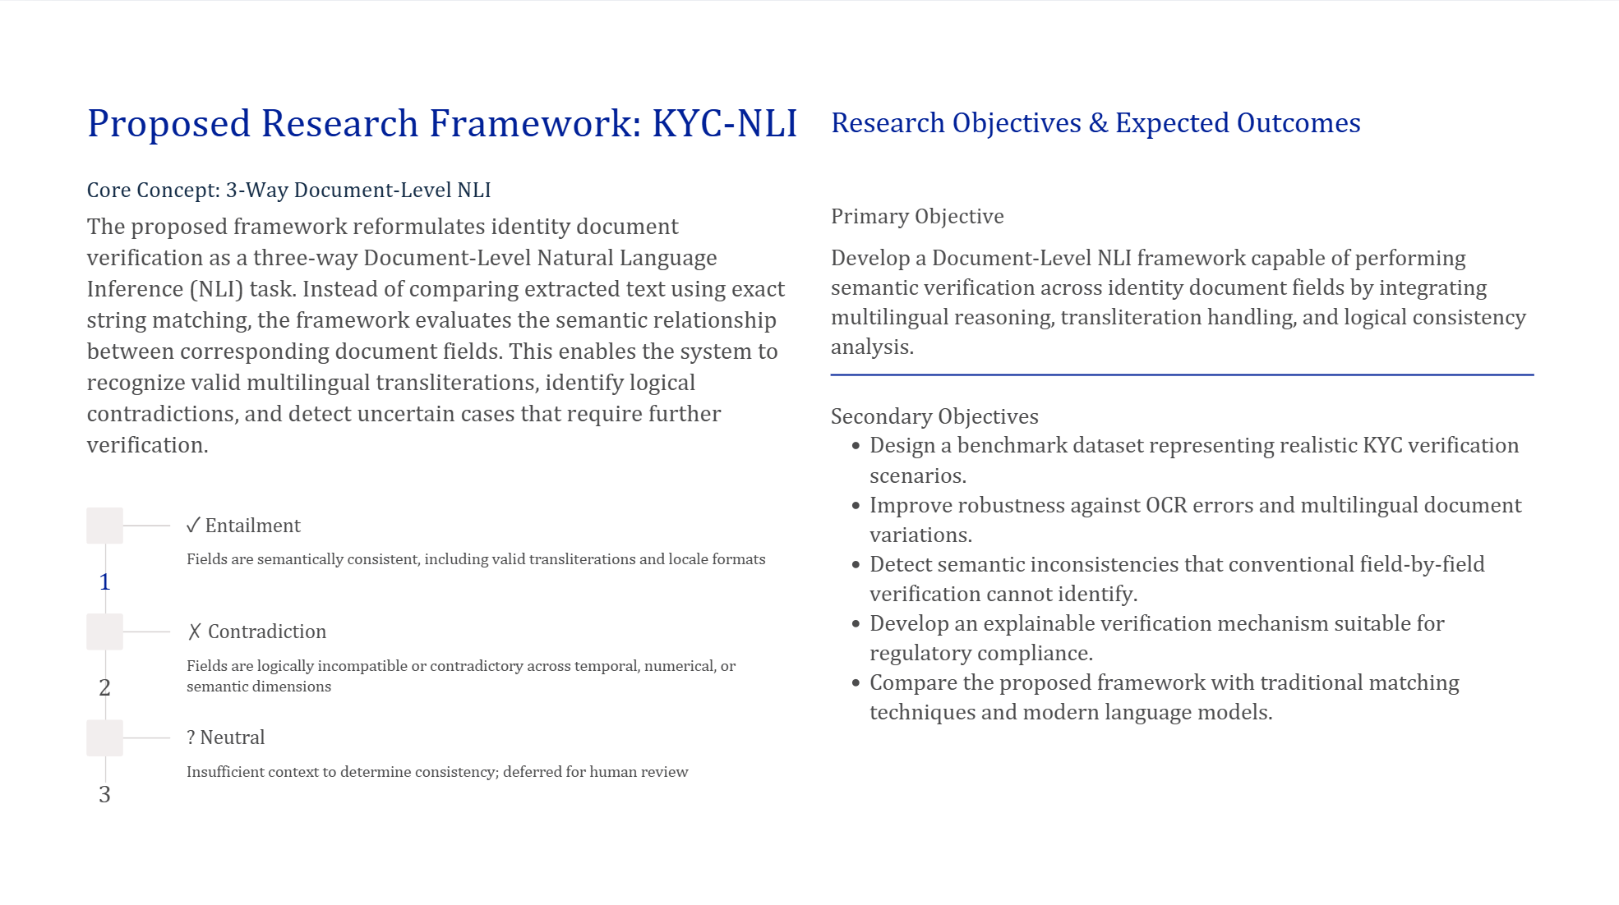
1 / 16

Slide 4
Literature Review — Paper 1 of 12
FakeIDet2: Privacy-Aware Detection of Fake Identity Documents
Section | Details
Paper Title | Privacy-Aware Detection of Fake Identity Documents: Methodology, Benchmark, and Improved Algorithms (FakeIDet2)
Authors | J. Muñoz-Haro, R. Tolosana, J. Fierrez, R. Vera-Rodriguez, A. Morales
Year | 2025
Journal / Conference | Information Fusion (Elsevier)
Problem Statement | Remote KYC systems face AI-generated/physical fake IDs (print, screen, composite). Real official ID data is too sensitive to share for training detectors, so labs use unofficial “real” IDs that don’t reflect official documents (99.06% vs 71.91% F1 gap, DeepID challenge).
Algorithm / Method Proposed | Patch-based, privacy-aware pipeline: (1) split ID into 64×64 / 128×128 patches at 3 anonymization levels; (2) fine-tuned DINOv2 (ViT-S/14) + AdaFace loss with dynamic class weights; (3) Multi-Head Self-Attention + attention pooling fuses patch embeddings → MLP real/fake classifier.
Dataset Used | FakeIDet2-db (proposed; 922,057 patches, 2,000 official Spanish IDs, 47 subjects); cross-DB: DLC-2021, KID34K, Benalcazar et al. synthetic Chilean IDs.
Evaluation Metrics | EER: 2.09% vs 54.08% (FakeIDet baseline) on composite attacks • 8.90% (DLC-2021), 13.84% (KID34K) cross-DB • 39.41% on synthetic/GAN (Benalcazar et al.) • anonymization degradation reported.
Advantages | Privacy-preserving via patching • strong composite-attack detection • good cross-DB generalization.
Disadvantages | Accuracy drops sharply with anonymization • poor GAN-generated-forgery generalization • sensor-sensitive • Spanish-ID-centric.
Research Gap | Image-only — no text/semantic cross-validation layer at all.
Future Scope | Authors point toward synthetic/GAN detection improvement and broader sensor generalization.

Slide 5
Literature Review — Paper 2 of 12
Optimizing Identity Documents Classification in Online Systems
Section | Details
Paper Title | Optimizing Identity Documents Classification in Online Systems
Authors | J. Voerman, M. Al-Ghadi, N. Sidere, M. Coustaty, O. Lessard
Year | 2025
Journal / Conference | IJDAR (Springer)
Problem Statement | Online KYC needs fast document-type classification as a pre-processing step, but ID confidentiality prevents building large labeled training datasets, ruling out standard deep learning.
Algorithm / Method Proposed | Comparative evaluation: CNNs (NasNet, EfficientNet) as accuracy benchmark vs. Prototypical Networks (few-shot, 1–5 samples) vs. Reduced Descriptor Matchers (SIFT/ORB/DISK/ALIKED + FLANN/LightGlue), single template per class.
Dataset Used | RVL-CDIP (400K docs, non-ID distractor class) • MIDV2020 (1,000 mock IDs, 10 classes) • IML3-ID (748 clips, 17 real French IDs, private).
Evaluation Metrics | ProtoNet accuracy: 96.42% (single-country) → 56.52% (all-docs) • ProtoNet(5-shot) & ORB+FLANN: 0.07s/doc • LightGlue combos: up to 17s/doc.
Advantages | Few-shot methods viable under real sample scarcity • fast inference options exist • untrained-class rejection tested.
Disadvantages | Few-shot accuracy degrades sharply as class count grows • LightGlue scales poorly • CNNs need unrealistic training volumes for confidential data.
Research Gap | No single method dominates across scenarios • no semantic/text-field validation of any kind.
Future Scope | Hybrid few-shot + retrieval-augmented approaches to handle scale (implied direction).
4 / 16

Slide 6
Literature Review — Paper 3 of 12
Enhanced NER Algorithm for Financial Document Verification
Section | Details
Paper Title | Enhanced NER Algorithm for Financial Document Verification
Authors | Toprak, Turan
Year | 2023
Journal / Conference | The Journal of Supercomputing (Springer)
Problem Statement | Verifying that financial summary reports faithfully match 100–150 page original documents is manual, slow, and error-prone (e.g. $5,000,000 mis-transcribed as $500,000).
Algorithm / Method Proposed | Pipeline: TextBlob spell-check (both docs) → fine-tuned BERT-base-cased NER (8 entity types) → regex rules for entity types the model wasn’t trained on (currency, location, email, %) → verification score = matching entities / total summary entities.
Dataset Used | Kaggle BBC News Summary dataset (business/entertainment/politics/sports/financial, 10 originals + 1 summary/category) • Kaggle NER dataset (47,959 sentences, 8 types) for BERT training.
Evaluation Metrics | 88.80% verification accuracy on financial docs (81.80% without regex rules) • Azure Cognitive Service baseline: 89.81% • ~2.4s average processing time.
Advantages | Fast (~2.4s/doc) • regex rules meaningfully boost accuracy • simple to adapt to new domains.
Disadvantages | No semantic verification — fails under abbreviation/format variance (“USA” vs “United States”) • small eval set (10 docs/category) • not tested on real banking documents.
Research Gap | Pure string/entity matching — no semantic equivalence handling; this IS the literalism problem.
Future Scope | Authors explicitly flag testing on real banking/production documents as future work.
5 / 16

Slide 7
Literature Review — Paper 4 of 12
Traceable LLM-Based Validation of Statements in Knowledge Graphs
Section | Details
Paper Title | Traceable LLM-Based Validation of Statements in Knowledge Graphs
Authors | Adam, Kliegr
Year | 2025
Journal / Conference | Information Processing & Management (Elsevier)
Problem Statement | LLMs can’t reliably trace which source information they used (50–90% of outputs unsupported by cited sources); millions of Wikidata statements lack citations or verification.
Algorithm / Method Proposed | Zero-shot LLM (Llama 3 70B / GPT-4) verification: given an RDF triple + a single retrieved text snippet, LLM answers a 3-way prompt (direct proof / partial indication / cannot be inferred). SPARQL identifies unsourced Wikidata statements at scale.
Dataset Used | BioRED-Verify (proposed; 3,438 statements: 1,719 positive + 1,719 negative via corrupted-triple generation) • Wikidata + linked Wikipedia articles for demonstrative use cases.
Evaluation Metrics | 88% precision, 44% recall • F1 comparable to PubMedBERT (59.0% vs 58.9%) • precision range 76–100%, recall range 10–84% across relation types.
Advantages | Traceable, human-readable justifications • zero-shot, no fine-tuning needed • scalable via automated SPARQL identification.
Disadvantages | Low recall (44%) — single-snippet limits evidence • highly variable by entity/relation type • no PDF/non-HTML handling • not tested on noisy/OCR text.
Research Gap | Single-snippet verification caps recall; no multi-source evidence aggregation.
Future Scope | Multi-source evidence aggregation to recover recall is the natural, unaddressed next step.
6 / 16

Slide 8
Literature Review — Paper 5 of 12
Structure-Guided Entity Resolution (SGER)
Section | Details
Paper Title | Structure-Guided Entity Resolution (SGER)
Authors | S. Chourasia, H. Kapoor, N. Patil
Year | 2026 (accepted)
Journal / Conference | ACL (Proceedings, 64th Annual Meeting)
Problem Statement | Matching person names across heterogeneous KYC records in linguistically/culturally complex environments (Indian identity data) is hard — LLMs struggle with structured naming ambiguity.
Algorithm / Method Proposed | Two-phase curriculum fine-tuning of an LLM (Llama 3 8B): Phase 1 — parse grammatical/semantic name structure into JSON; Phase 2 — optimize for downstream binary entity-match classification. Deployed via vLLM in production.
Dataset Used | Proprietary, anonymized Indian KYC production records (Dream11); held-out test set of 50,000 real-world name pairs.
Evaluation Metrics | 99.02% accuracy, F1 = 0.994 — outperforms GPT-4o few-shot prompting and single-stage fine-tuning baselines.
Advantages | Production-deployed at massive scale (250M+ users) • curriculum learning handles compound distortions (OCR + reordering + missing whitespace) well.
Disadvantages | Binary label space only — no “insufficient evidence” judgment • personal names only, not general fields • proprietary, non-reproducible training data • no public benchmark.
Research Gap | Cannot represent multi-field joint contradictions (e.g. date × template-era) or a neutral judgment, by construction.
Future Scope | Authors explicitly flag extending to multimodal identity-document processing to resolve OCR noise at its image origin.
7 / 16

Slide 9
Literature Review — Paper 6 of 12
Cross-Document Cross-Lingual NLI (CDCL-NLI)
Section | Details
Paper Title | Cross-Document Cross-Lingual NLI (CDCL-NLI)
Authors | M. Yuan, W. Wang, Z. Wang, Y. Huang, K. Wei, F. Li, C. Teng, D. Ji
Year | 2025
Journal / Conference | EMNLP (Proceedings)
Problem Statement | Cross-lingual NLI transfer is documented to degrade under language shift, but cross-document, multilingual entailment reasoning remains largely unexplored relative to sentence/document-level NLI.
Algorithm / Method Proposed | Rhetorical Structure Theory (RST) + Relation-aware Graph Attention Network (RGAT) fuses evidence across multiple, multilingual premise documents against one hypothesis; lexical-chain-based cross-lingual alignment; EDU-level extractive interpretability.
Dataset Used | CDCL-NLI (proposed) — 25,410 instances spanning 26 languages, multi-document premises.
Evaluation Metrics | Reports substantial performance gaps for strong document-level NLI baselines and LLMs under cross-lingual test conditions vs. same-language conditions (exact figures not confirmed from abstract-level source).
Advantages | Jointly reasons across multiple multilingual documents • EDU-level interpretability • large, diverse released dataset.
Disadvantages | Requires multiple premise documents by construction • targets translation-style shift, not transliteration (script-level) equivalence • compute-heavy graph-fusion pipeline.
Research Gap | Not applicable to single-document, multi-zone field-pair consistency checks; no OCR-noise dimension.
Future Scope | Extension toward single-document, script-level (not just language-level) entailment is an open direction.
8 / 16

Slide 10
Literature Review — Paper 7 of 12
Entailed Between the Lines: Incorporating Implication into NLI
Section | Details
Paper Title | Entailed Between the Lines: Incorporating Implication into NLI
Authors | S. Havaldar, H. Alvari, J. Palowitch, M. J. Hosseini, S. Buthpitiya, A. Fabrikant
Year | 2025
Journal / Conference | ACL (Proceedings, Vol. 1, pp. 32274–32290)
Problem Statement | State-of-the-art NLI models and datasets struggle to recognize entailment that is implied rather than explicitly stated in the text.
Algorithm / Method Proposed | Formalizes implied entailment as a 4-way extension of standard 3-way NLI (explicit / implicit / neutral / contradictory); introduces the Implied NLI (INLI) dataset; fine-tunes LLMs (e.g. T5-XXL) to recognize and distinguish implied vs. explicit entailment.
Dataset Used | INLI (proposed) — 10K premises mirroring real-world communication, 40K hypotheses (implied / explicit / neutral / contradictory), built from existing implicature-frame datasets.
Evaluation Metrics | Demonstrates a clear performance gap between explicit- and implicit-entailment recognition in SOTA models; fine-tuning on INLI improves and generalizes across datasets/domains.
Advantages | Generalizes across datasets/domains once fine-tuned • identifies a real, previously under-measured NLI blind spot.
Disadvantages | General-domain, sentence-level focus — not structured/field-level • no temporal/numerical or OCR-noise treatment.
Research Gap | Implied entailment in short, low-context structured fields (e.g. identity-document fields) is unstudied.
Future Scope | Domain-specific extensions of implied entailment to structured/professional text are an open direction.
9 / 16

Slide 11
Literature Review — Paper 8 of 12
Evaluating Robustness of LLMs in QA on Multilingual Noisy OCR Data (MultiOCR-QA)
Section | Details
Paper Title | Evaluating Robustness of LLMs in QA on Multilingual Noisy OCR Data (MultiOCR-QA)
Authors | B. Piryani, J. Mozafari, A. Abdallah, A. Doucet, A. Jatowt
Year | 2025
Journal / Conference | CIKM (34th ACM International Conference)
Problem Statement | The impact of OCR noise on downstream LLM reasoning tasks, under multilingual conditions, is under-evaluated relative to OCR's impact on extraction alone.
Algorithm / Method Proposed | Zero-shot evaluation of state-of-the-art general-purpose LLMs on paired RawOCR vs. CorrectedOCR passages for question answering, isolating the performance delta attributable purely to OCR-induced errors.
Dataset Used | MultiOCR-QA (proposed) — 50K–60K QA pairs across English/French/German, curated from OCR’d historical documents with graded noise levels.
Evaluation Metrics | Reports LLMs are highly prone to OCR-induced errors and perform poorly on noisy OCR text relative to corrected.
Advantages | Controlled paired-context design isolates the pure OCR-noise effect • multilingual (3 languages) • graded noise levels.
Disadvantages | QA-task framing only, not entailment/verification • historical-document OCR noise profile may not match modern ID-scan OCR • no mitigation method proposed — diagnostic only.
Research Gap | No equivalent OCR-noise robustness study exists for entailment or field-verification tasks specifically.
Future Scope | Extending OCR-robustness evaluation methodology to reasoning/verification tasks beyond QA.
10 / 16

Slide 12
Literature Review — Paper 9 of 12
Large Language Models and Data Quality for Knowledge Graphs
Section | Details
Paper Title | Large Language Models and Data Quality for Knowledge Graphs
Authors | S. Marchesin, G. Silvello, O. Alonso
Year | 2025
Journal / Conference | Information Processing & Management (Elsevier)
Problem Statement | The growing use of LLMs across knowledge-graph data-quality tasks (verification, cleaning, completion) lacks a systematic, cross-study synthesis.
Algorithm / Method Proposed | Guest editorial introducing an IPM special issue — not a survey. Frames the problem space of LLMs in KG data quality and introduces the issue's contributed papers.
Dataset Used | Synthesis across multiple published KG/LLM benchmark datasets (secondary/meta-analysis; no single proposed dataset).
Evaluation Metrics | Editorial format: no empirical results of its own.
Advantages | Assembles a current set of contributed papers on LLMs for KG data quality • useful as a pointer into that literature.
Disadvantages | An editorial, not a systematic review: no stated search protocol and no cross-study synthesis of its own • cite it as a pointer, not as evidence.
Research Gap | No benchmark exists specifically for noisy/OCR-derived text feeding into KG-relevant verification tasks.
Future Scope | Primary empirical benchmark work bridging LLM+KG data quality with noisy real-world input is an open need.
11 / 16

Slide 13
Literature Review — Paper 10 of 12
Knowledge Graph Validation by Integrating LLMs and Human-in-the-Loop
Section | Details
Paper Title | Knowledge Graph Validation by Integrating LLMs and Human-in-the-Loop
Authors | S. Tsaneva, D. Dessì, F. Osborne, M. Sabou
Year | 2025
Journal / Conference | Information Processing & Management (Elsevier)
Problem Statement | Fully automated LLM-based KG triple validation risks unreliable judgments; fully manual validation doesn’t scale — the field needs a balance.
Algorithm / Method Proposed | LLM-based triple-validation pipeline combined with a structured human-in-the-loop review step: LLM proposes validity judgments; human reviewers verify/correct a sampled subset to close the reliability loop.
Dataset Used | Scholarly/domain knowledge-graph triples (exact corpus per publisher record; full composition behind paywall).
Advantages | Combines automation with human oversight to raise overall validation reliability.
Disadvantages | Human-in-the-loop step caps full automation and throughput • reliability depends on reviewer expertise and sampling coverage • not evaluated on noisy/OCR-derived or identity-document input.
Research Gap | No field-level, document-structured validation approach; no OCR-noise handling.
Future Scope | Scaling human-in-loop efficiency and extending validation to structured document fields.
12 / 16

Slide 14
Literature Review — Paper 11 of 12
Advances in Machine Transliteration Methods, Limitations, Challenges, Applications and Future Directions
Section | Details
Paper Title | Advances in Machine Transliteration Methods, Limitations, Challenges, Applications and Future Directions
Authors | A. Syauqi, A. P. Wibawa
Year | 2025
Journal / Conference | Natural Language Processing Journal (Elsevier)
Problem Statement | Transliteration research (rule-based, statistical, ML/neural, hybrid) is fragmented across the literature without a unified, systematic synthesis.
Algorithm / Method Proposed | PRISMA-based systematic literature review of 73 studies retrieved via Scopus, categorized by transliteration technique family and downstream NLP application area.
Dataset Used | 73 selected studies (secondary/meta-analysis; no primary dataset of its own).
Evaluation Metrics | Not applicable — survey format, no new empirical results.
Advantages | Comprehensive categorization across technique families and application domains.
Disadvantages | No new transliteration model or benchmark proposed • ML-based methods noted as constrained by data scarcity for low-resource language pairs.
Research Gap | No coverage of identity-document-specific transliteration matching (e.g. MRZ ↔ VIZ script pairs).
Future Scope | Authors call for more work on low-resource-language transliteration and hybrid semantic-knowledge methods.
13 / 16

Slide 15
Literature Review — Paper 12 of 12
Forged Presentation Attack Detection for ID Cards on Remote Verification Systems
Section | Details
Paper Title | Forged Presentation Attack Detection for ID Cards on Remote Verification Systems
Authors | S. González, J. E. Tapia
Year | 2025
Journal / Conference | Pattern Recognition (Elsevier)
Problem Statement | Remote identity-verification systems are vulnerable to forged presentation attacks (manipulated ID card images) submitted during the remote capture flow.
Algorithm / Method Proposed | Hybrid two-stage multiclass network for end-to-end presentation-attack detection, built on MobileNetV2: a serial two-stage architecture trained from scratch.
Dataset Used | Chilean ID card database of 190K real-case images, plus new fake images from synthetic and PVC ID cards; not publicly released due to privacy constraints.
Advantages | Among the first end-to-end PAD evaluations on ID cards • the two-stage design separates detection from attack-type classification.
Disadvantages | Single-country, non-public dataset limits reproducibility and cross-country generalization claims • vision-only, no textual/semantic layer.
Research Gap | No semantic/text-field cross-validation of any kind.
Future Scope | Cross-country dataset expansion and multimodal (text) extension are natural next steps.
14 / 16

Slide 16
Comparative Analysis
Paper | Problem | Algorithm | Dataset | Advantages | Limitations | Research Gap | How My Idea Improves
FakeIDet2 (2025) | Fake ID detection | DINOv2+AdaFace, patch fusion | FakeIDet2-db | Privacy-preserving, strong on composites | Image-only, poor on GAN fakes | No semantic/text layer | NLI adds field-level semantic check on top of any vision signal
Voerman et al. (2025) | ID doc classification | CNN vs ProtoNet vs RDM | MIDV2020, RVL-CDIP, IML3-ID | Few-shot viable under scarcity | Degrades with class count | No text validation | Orthogonal — feeds a document-type prior into the pipeline
Toprak & Turan (2023) | Summary-vs-source verification | BERT NER + regex | Kaggle BBC + NER set | Fast, simple to adapt | Fails on format/abbrev. variance | Literal matching, not semantic | NLI replaces string equality with entailment
Adam & Kliegr (2025) | KG statement verification | Zero-shot LLM, 3-way | BioRED-Verify | Traceable, zero-shot | Low recall, single snippet | No multi-source aggregation | Multi-zone field NLI aggregates evidence across the whole document
SGER (2026) | KYC name matching | 2-phase curriculum FT | Dream11 KYC (50K pairs) | Production-proven at scale | Binary, name-only | No neutral class, no multi-field | 3-way, multi-field NLI generalizes SGER's task formulation
CDCL-NLI (2025) | Cross-doc, cross-lingual NLI | RST + RGAT graph fusion | CDCL-NLI (25,410 inst.) | Multi-doc, multilingual, interpretable | Needs multiple premise docs | Translation, not transliteration | Adapts 3-way entailment to single-doc, script-level equivalence
Entailed Between the Lines (2025) | Implied entailment in NLI | 4-way NLI + INLI dataset | INLI (10K/40K) | Generalizes across domains | General-domain only | No structured/field-level study | Motivates handling implicit equivalence in identity fields
MultiOCR-QA (2025) | OCR-noise robustness in QA | Zero-shot LLM, paired eval | MultiOCR-QA (50–60K) | Controlled, multilingual | QA only, no mitigation | No entailment/verification task | Motivates explicit OCR-noise eval for the NLI mechanism
Marchesin et al. (2025) | LLM role in KG data quality | Editorial, not a survey | None (editorial) | Cross-study synthesis | No new benchmark | No noisy-text treatment | Positions NLI as an underused KG-quality mechanism
Tsaneva et al. (2025) | KG triple validation | LLM + human-in-the-loop | Scholarly KG triples | Reliability via human oversight | Caps automation/throughput | No document-field validation | NLI removes need for per-triple human review at field level
Syauqi & Wibawa (2025) | Transliteration landscape | PRISMA review, 73 studies | 73 studies (meta) | Comprehensive categorization | No new model | No ID-document coverage | Fills the identity-document transliteration gap directly
Gonzalez & Tapia (2025) | ID card presentation attacks | MobileNetV2, 2-stage serial | Chilean ID DB (190K) | Per-attack-type detection | Single-country, non-public | No semantic layer | NLI adds a reproducible, text-based verification layer
15 / 16

Slide 17


Research Gap Analysis & Proposed Research Contributions
Common Research Gaps
Why Our Proposed Idea Is Better
Vision-centric verification: Most existing methods focus primarily on document image classification or forgery detection, while providing limited semantic validation of relationships between extracted document fields.
Dependence on exact text matching: Conventional verification pipelines rely on OCR outputs and literal string comparison, making them vulnerable to multilingual documents, formatting variations, and legitimate transliterations.
Limited cross-field reasoning: Current approaches generally validate fields independently and do not model logical dependencies between identity attributes such as names, dates, document versions, and security features.
Insufficient multilingual and transliteration support: Existing methods rarely address cross-script identity verification where equivalent names are represented in different writing systems or transliteration standards.
Sensitivity to OCR noise: OCR extraction errors propagate through downstream verification modules, reducing matching accuracy and increasing both false positives and false negatives.
Lack of standardized semantic benchmarks: There is no widely adopted benchmark for evaluating semantic consistency, logical reasoning, and multilingual identity verification at the document level.
Reformulates identity verification as a three-way Document-Level Natural Language Inference (NLI) task, enabling semantic reasoning through Entailment, Contradiction, and Neutral decisions rather than binary matching.
Integrates semantic field verification with multilingual transliteration handling, allowing equivalent identities across different scripts and regional formats to be correctly recognized.
Introduces cross-field logical reasoning, enabling verification of temporal, numerical, and contextual consistency between related document attributes instead of validating each field independently.
Improves robustness against OCR-induced errors through semantic inference, reducing the cascading impact of imperfect text extraction on downstream verification.
Develops a dedicated KYC-NLI benchmark containing realistic multilingual identity verification scenarios, minimal-pair contrast sets, and semantic consistency labels for comprehensive model evaluation.
Provides explainable verification decisions by identifying supporting and conflicting document fields, increasing transparency, auditability, and suitability for regulatory KYC/AML compliance.
16 / 16

